Slide 1
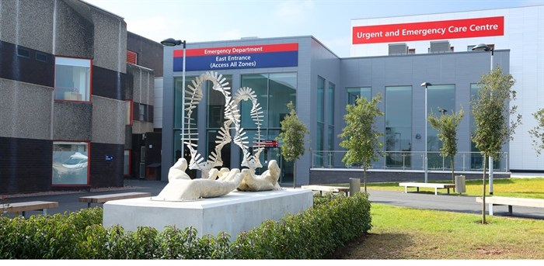
Wolverhampton Emergency and Critical Care Echocardiography Course
Course Director: Dr. Cyril Jacob Chacko
Date : Monday 16th September 2024
Venue : Wolverhampton Medical Institute,
New Cross Hospitals
Basic physics, Ultrasound machine demonstration
Knobology, Image acquisition and optimization
Sonoanatomy, Live demonstration of basic echo views
Common pathologies and Interesting cases
Hands–on sessions, FUSIC accreditation process
Syllabus
Focused Ultrasound in Intensive Care (FUSIC) covering modules of FUSIC Heart and Lung
CPD credits: 5 CPD credits from RCOA
Course Fees: 250£
For Registration contact:
Barry Hewitt
E-mail : barry.hewitt@nhs.net

